Slide 1
Software Project Estimation
Credits: Ms. Rubab

Slide 2
What is Project Estimation?
define project scope
  Describe scope, assumptions, constraints
  Define estimated functional points (business req.)
  Define WBS
Define estimated time
  Make activity lists as per WBS
  Create network diagram to show the flow
Define estimated cost
  Resource (people, equipment)
  Licensing fees /other charges
  Admin costs
  Trainings if needed
After that project manager put forward the proposal for acceptance.

Slide 3
Estimation is good for
Stakeholders
  Have confidence about the design
Vendors
  They can manage their budget as per the efforts
Team members
  Got idea about
    What to do?
    When to do?
Project manger
  Everyone is on same page so less management burden

Slide 4
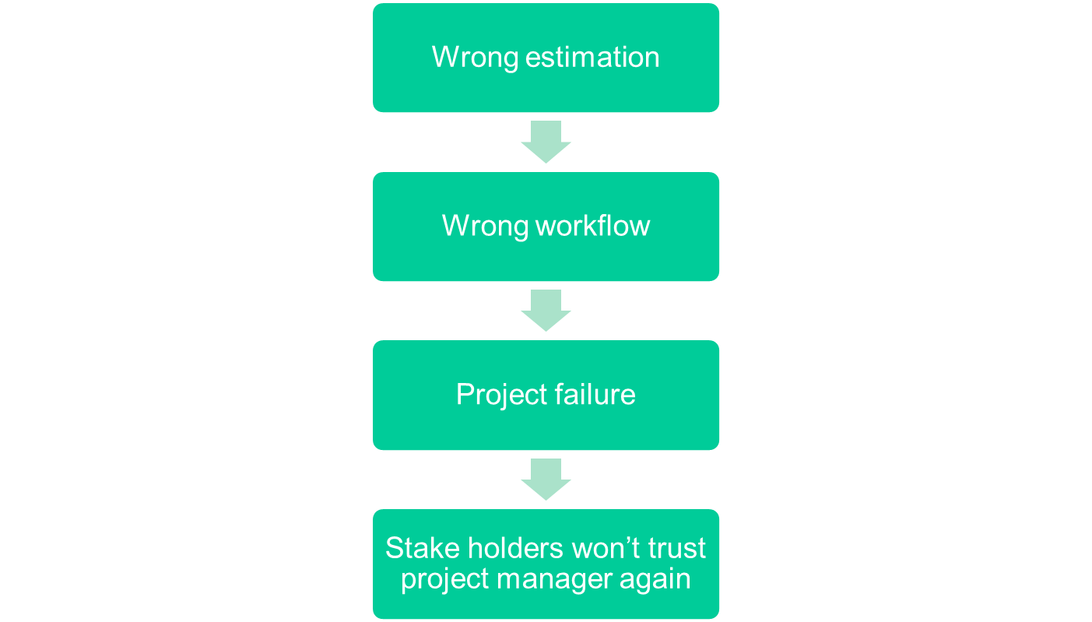
Importance of Cost estimation

Slide 5
For good estimation, following are needed:
  A work breakdown structure (WBS)
  list of tasks that will produce the final product
  A clear effort estimation for each task
  A list of assumptions which were necessary for making the estimate
  Consensus among the project team that the estimate is accurate

Slide 6
Assumptions Make Estimates More Accurate
Team members make assumptions about the work to be done in order to deal with incomplete information
  Must estimate the issues needed to make decision
  Assumptions must be written down so that if they prove to be incorrect then it must be back tracked and corrected.

Slide 7
Wideband Delphi
Wideband Delphi is a process that a team can use to generate an estimate
  The project manager chooses an estimation team,
  and gains consensus among that team on the results
  Wideband Delphi is a repeatable estimation process because it consists of a straightforward set of steps that can be performed the same way each time

Slide 8
Delphi TECHNIQUE
Take inputs from multiple stake holders
Create final estimate on that
Steps followed:
  Must have a facilitator/coordinator
  Create list of experts
  Create 3-5 questions
    For example what's better to use for project? Azure / AWS etc..….
  Reach to all the results
  Analyze & iterate

Slide 9
steps to follow
Coordinator presents each expert with a specification and an estimation form.
Coordinator calls a group meeting in which the experts discuss estimation issues with the coordinator and each other.
Experts fill out forms anonymously.
Coordinator prepares and distributes a summary of the estimates
Coordinator calls a group meeting, specifically focusing on having the experts discuss points where their estimates vary widely
Experts fill out forms, again anonymously, and steps 4 to 6 are iterated for as many rounds as appropriate.

Slide 10
The Wideband Delphi Process
Step 1: Choose the team
  The project manager selects the estimation team and a moderator. The team should consist of 3 to 7 project team members.
    The moderator should be familiar with the Delphi process, but should not have a stake in the outcome of the session if possible.
    If possible, the project manager should not be the moderator because he should ideally be part of the estimation team.
http://www.stellman-greene.com

Slide 11
The Wideband Delphi Process
Step 2: Kickoff Meeting
  The project manager must make sure that each team member understands the Delphi process, has read the vision and scope document and any other documentation, and is familiar with the project background and needs.
  The team brainstorms and writes down assumptions.
  The team generates a WBS with 10-20 tasks.
  The team agrees on a unit of estimation.

Slide 12
The Wideband Delphi Process
Step 3: Individual Preparation
  Each team member independently generates a set of preparation results.
  For each task, the team member writes down an estimate for the effort required to complete the task,
  and any additional assumptions he needed to make in order to generate the estimate.

Slide 13
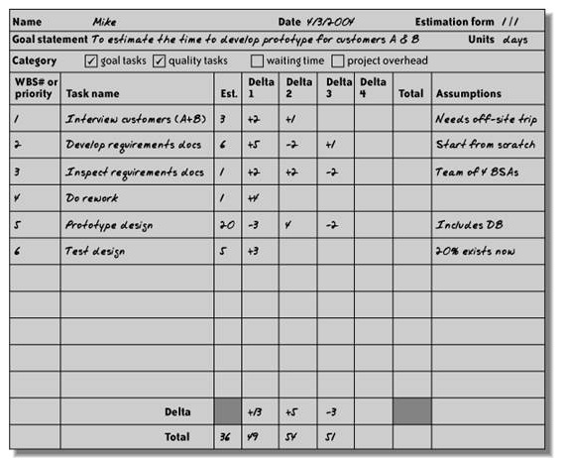
Estimation form

Slide 14
The Wideband Delphi Process
Step 4: Estimation Session
  During the estimation session, the team comes to a consensus on the effort required for each task in the WBS.
  Each team member fills out an estimation form which contains his estimates.
  The rest of the estimation session is divided into rounds during which each estimation team member revises her estimates based on a group discussion. Individual numbers are not discussed.

Slide 15
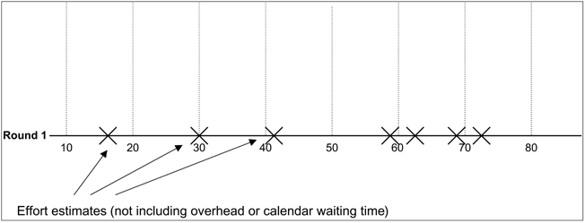
The Wideband Delphi Process
Step 4: Estimation Session (continued)
  The moderator collects the estimation forms and plots the sum of the effort from each form on a line:

Slide 16
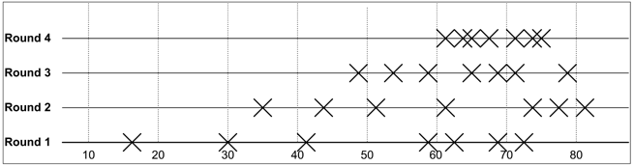
The Wideband Delphi Process
Step 4: Estimation Session (continued)
  The team resolves any issues or disagreements that are brought up.
    Individual estimate times are not discussed. These disagreements are usually about the tasks themselves. Disagreements are often resolved by adding assumptions.
  The estimators all revise their individual estimates. The moderator updates the plot with the new total:

Slide 17
The Wideband Delphi Process
Step 4: Estimation Session (continued):
  The moderator leads the team through several rounds of estimates to gain consensus on the estimates. The estimation session continues until the estimates converge or the team is unwilling to revise estimates.
Step 5: Assemble Tasks
  The project manager works with the team to collect the estimates from the team members at the end of the meeting and compiles the final task list, estimates and assumptions.
Step 6: Review Results
  The project manager reviews the final task list with the estimation team.

Slide 18
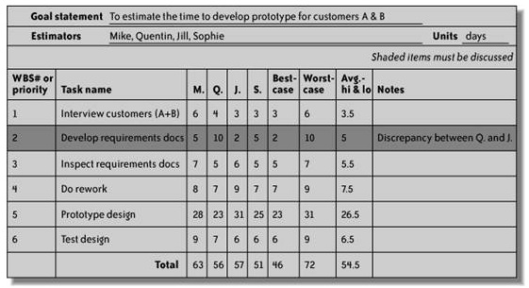
Summarized result of estimation

Slide 19
Other Estimation Techniques
PROBE, or Proxy Based Estimating
  PROBE is based on the idea that if an engineer is building a component similar to one he built previously, then it will take about the same effort as it did in the past.
  Individual engineers use a database to maintain a history of the effort they have put into their past projects.
  A formula based on linear regression is used to calculate the estimate for each task from this history.
COCOMO II
  In Constructive Cost Model, or COCOMO, projects are summarized using a set of variables that must be provided as input for a model that is based on the results of a large number of projects across the industry.
  The output of the model is a set of size and effort estimates that can be developed into a project schedule.

